Slide 1
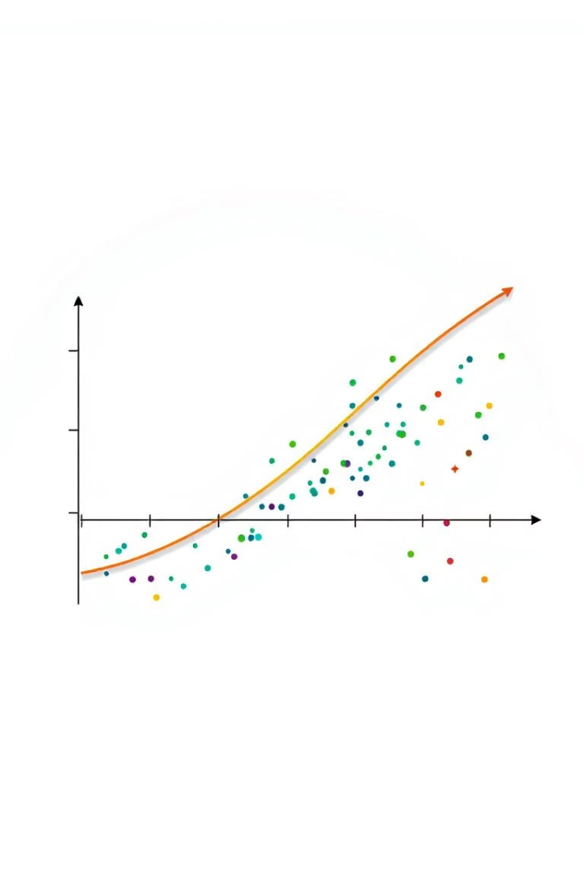
Predicting Diabetes: A Classification Model
This project develops a machine learning model to predict diabetes risk using Pima Indians Diabetes Database. Accurate early prediction aids prevention and treatment.

Slide 2
Data Overview: Understanding the Dataset
Key Variables
Age, BMI, Blood Pressure, Glucose Level, Family History
Data Cleaning
Handled missing values and outliers to ensure quality
Dataset Size
Approximately 10,000 patient records analyzed
Demographics
Balanced age, gender, and race/ethnicity representation

Slide 3
Feature Engineering: Preparing Data for the Model
BMI Calculation
Glucose Categorization
One-Hot Encoding
Feature Scaling
Uses weight (kg) / height (m)^2 formula
Normalizes features with StandardScaler for model consistency
Classifies levels into Normal, Pre-diabetes, and Diabetes
Transforms categorical variables to numerical format

Slide 4





Model Selection: Choosing the Right Algorithm
Logistic Regression
Simple and interpretable baseline model
Random Forest
Handles non-linear data robustly
Support Vector Machine
Effective for high-dimensional feature spaces
Hyperparameter Tuning
GridSearchCV optimizes model parameters

Slide 5
Logistic Regression Algorithm
Logistic regression models the probability of diabetes based on risk factors.
It outputs values between 0 and 1, classifying patients' diabetes risk.

Slide 6
Model Training and Evaluation
Train/Test Split
Cross-Validation
Used 80% training and 20% testing data
10-fold cross-validation enhances reliability
Evaluation Metrics
Performance
Model accuracy shows significant improvement over baseline
Accuracy
Precision
Recall
F1-Score
AUC-ROC

Slide 7
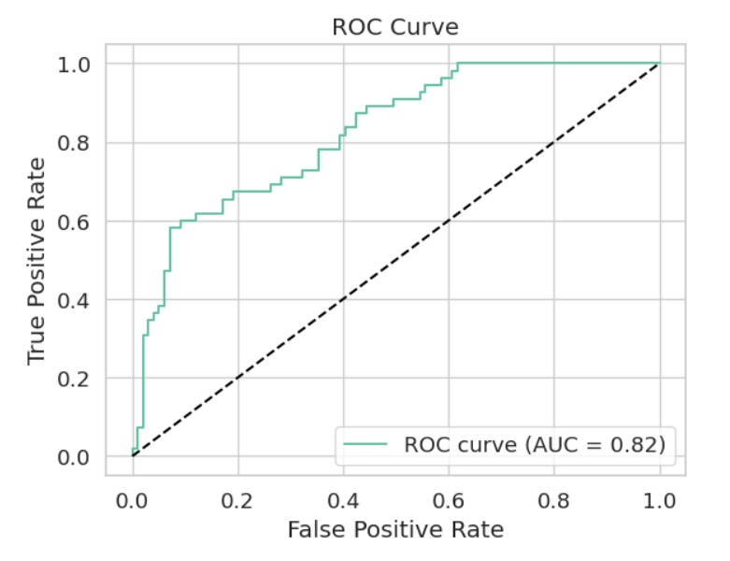
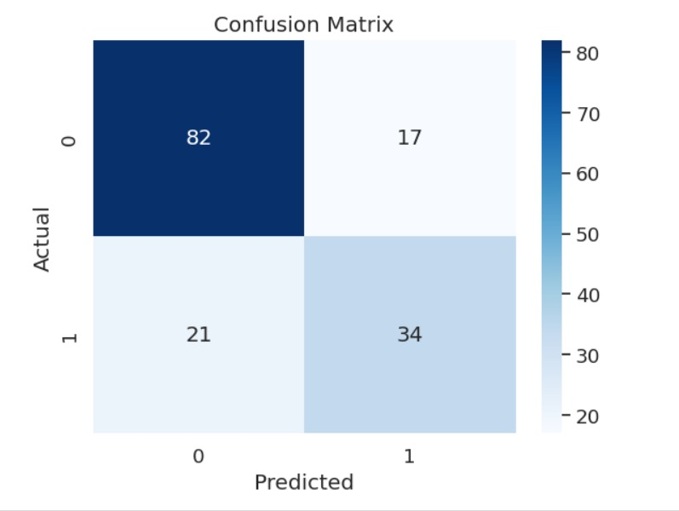
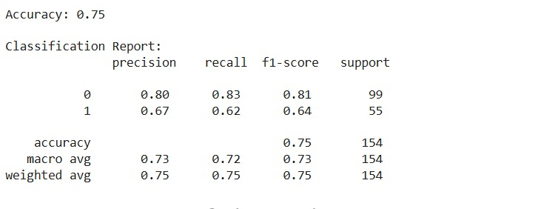
Results Visualization: Model Performance
Confusion Matrix
Feature Importance
Visualizes true/false positives and negatives clearly
Highlights most influential risk factors
ROC Curve
Visual Tools
Shows sensitivity vs specificity trade-offs
Matplotlib and Seaborn create detailed graphs

Slide 8
Conclusion and Next Steps
Performance Summary
High accuracy, precision, and recall metrics achieved
Limitations
Challenges include data bias and limited features
Future Work
Plan to add features and deploy for real-world use
Ethical Focus
Ensuring privacy and transparency in model use

Slide 9
THANK YOU

